Slide 1
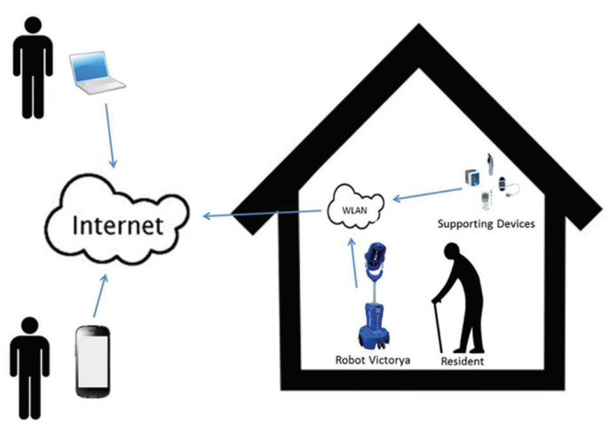
Telepresence Technology General Introduction
Remote Control
Users can operate the robot even though he is far away from it.
Have a stable and secure control system in case of external disturbance
Remote Viewing
Able to be shared by different people or multiple robots controlled by one person
Users can use the robot to view the surrounding environment remotely
Provide stable and continuous transmission of information including video or data
The information is protected and secure
The telepresence robot can serve as a substitute of user who is far away!

Slide 2
Telepresence Technology Application in our project
Patients can drive the robot to their building remotely.
Doctors can use the robot to run primary diagnosis.
Smart Robot
Controllable chassis
Various sensors
Pill dispenser
Telepresence
Remote communication
Data transmission
Multiple users
Tele-Doctor
Shared by community
Door-to-door service
Remote diagnosis

Slide 3
Telepresence Technology Hardware Realization
Telepresence
Internet connection
-WIFI/4G/5G penetration
-Wireless network card
Remote communication
-Camera/Screen for video
-Speaker/microphone for audio
Smart Robot
Dynamical System
-A stable and flexible moving chassis
-A pill dispenser controlled by a servo motor
-Battery system
Various Sensors
-Supersonic or infrared sensors to avoid crash
-sphygmomanometer and thermometer to run primary diagnosis on patients

Slide 4
Telepresence Technology Software Realization
Telepresence
Communication platform
-Build an Internet platform based on WWW to establish stable communication between any user and the robot
Information security
-Use password to protect the privacy
-Use encryption technology to ensure the control process won’t be interrupted
Smart Robot
Interactive System
-Develop a interactive interface so that doctors and the users can control the robot easily
Data transmission
-Use typical data transmission protocols to have access and record data collected by sensors and medical devices

Slide 5
Telepresence Technology Future prospect
Telepresence
Robot
Human
Shorten the distance between people far away from each other
More applications:
Elderly healthcare
Space exploration
Robot teacher
Military reconnaissance
Narrow the difference between robot and human

